Slide 1
Linear regression project
Topic – vehicle dataset
by – prerak jain

Slide 2
Contents
Aim
Objective
Data collection
Eda
Linear regression

Slide 3
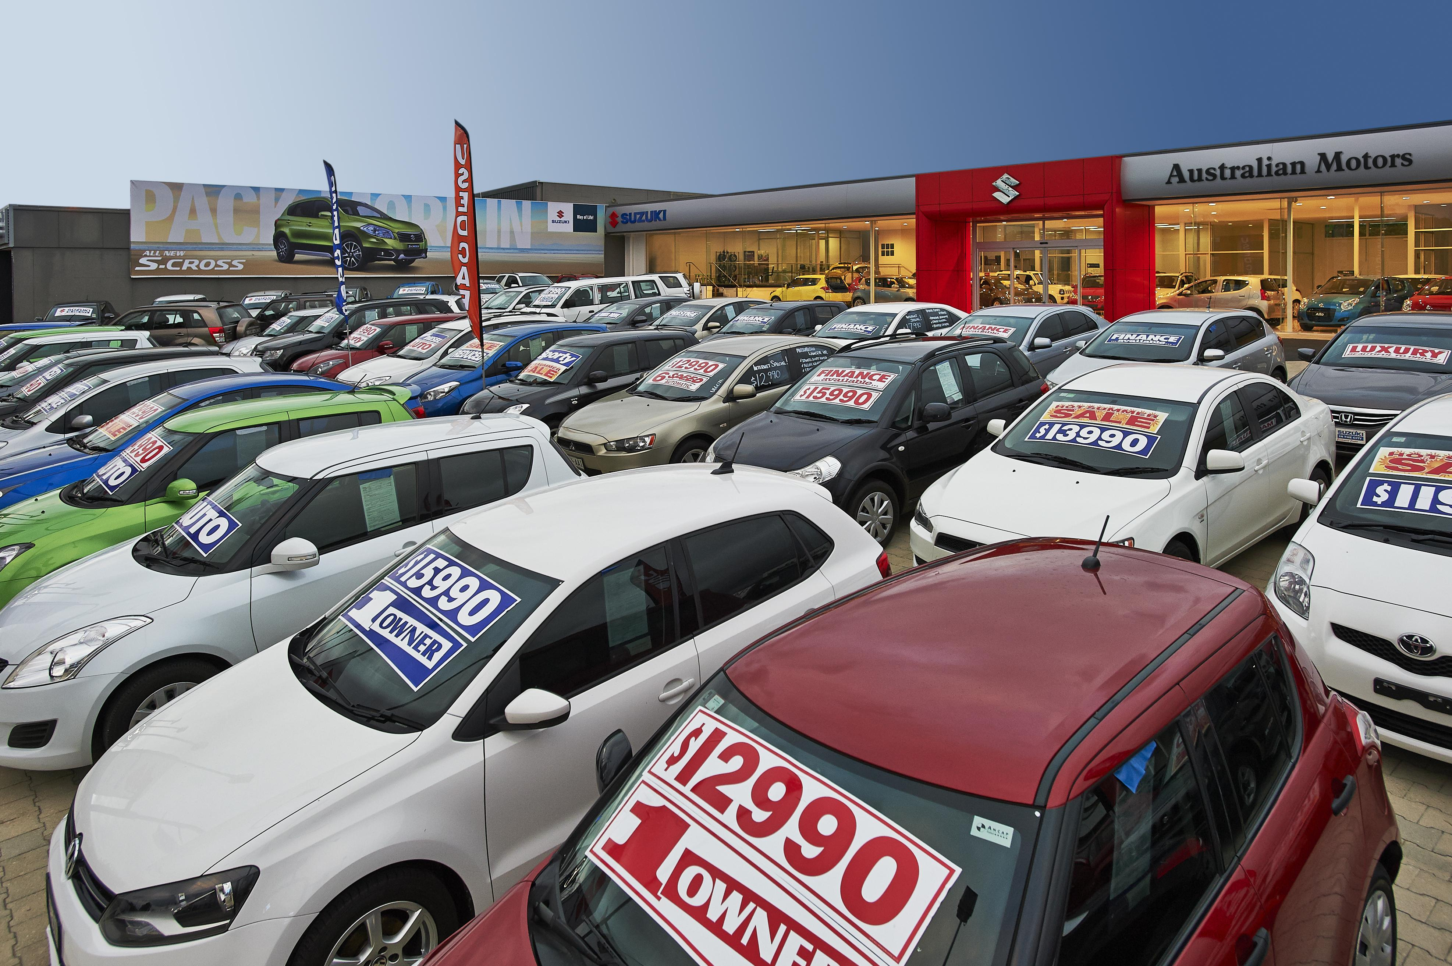

Aim - To USE LINEAR REGRESSION IN ORDER TO MODEL CAR PRICE PREDICTION objective – to deliver the accuracy of the car price prediction model
Source – Google images
Source – Google images

Slide 4
Vehicle dataset
The dataset is about the selling price of used cars in the market, which depends on the factors such as distance travelled, year, fuel type, owner, transmission and age.
The dataset is available on Kaggle
The dataset give details about 4340 cars in total.
The data contains few missing values from some columns which will be treated in eda section
We will also visualize the data with different types of graphs
Lastly, we will perform linear regression on the dataset.

Slide 5
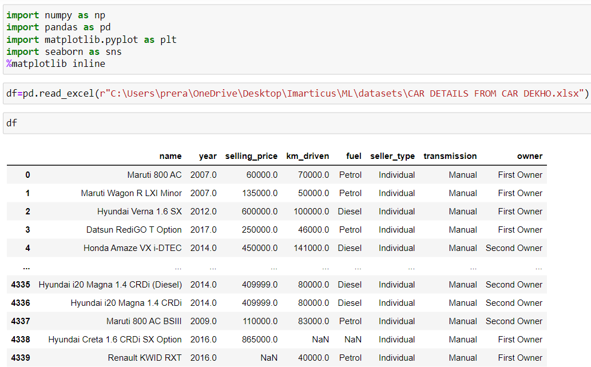
Data collection

Slide 6
EXPLORATORY DATA ANALYSIS

Slide 7
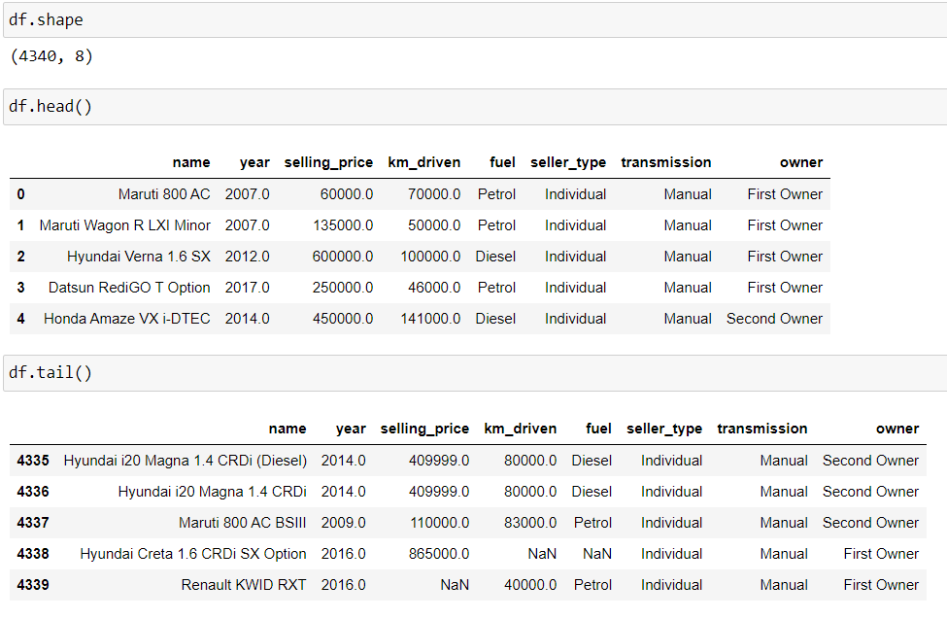
Important characteristics

Slide 8
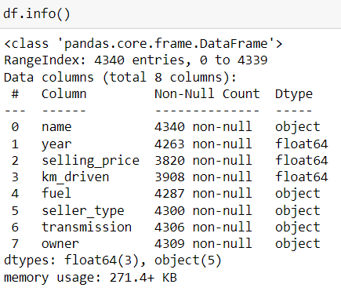
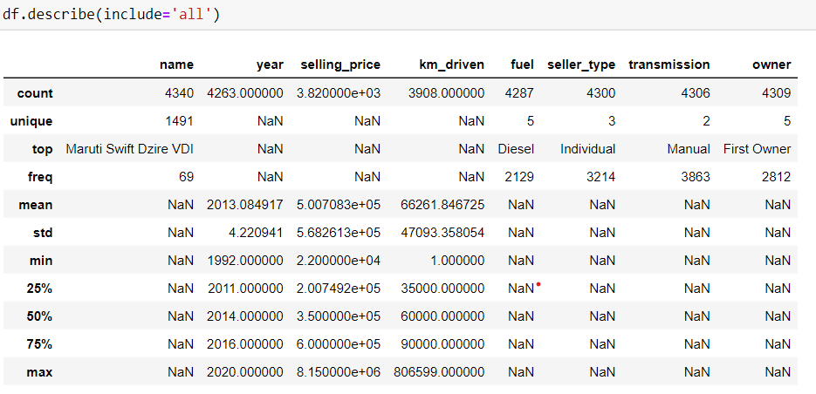

Slide 9
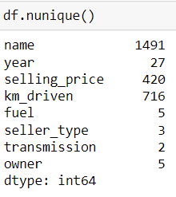
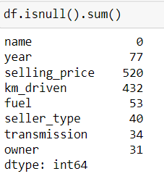
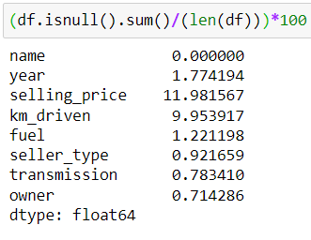
Unique values
MISSING VALUES
PERCENTAGE MISSING VALUES

Slide 10
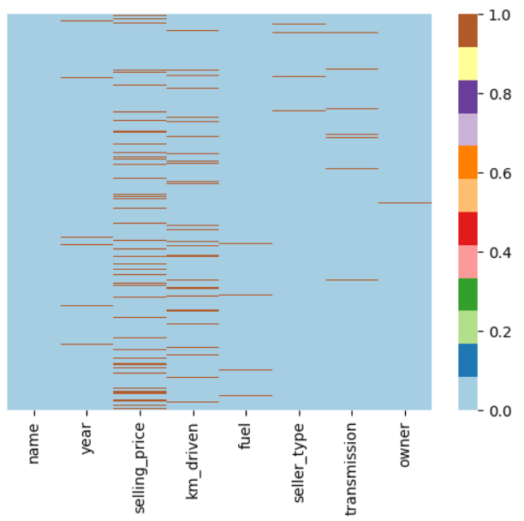
Heatmap of missing values

Slide 11
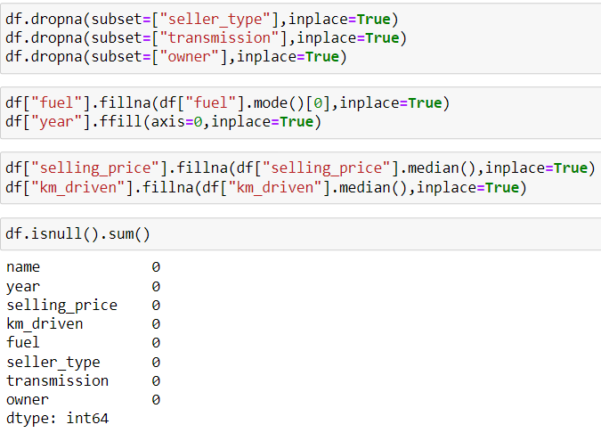
MISSING VALUES TREATMENT

Slide 12
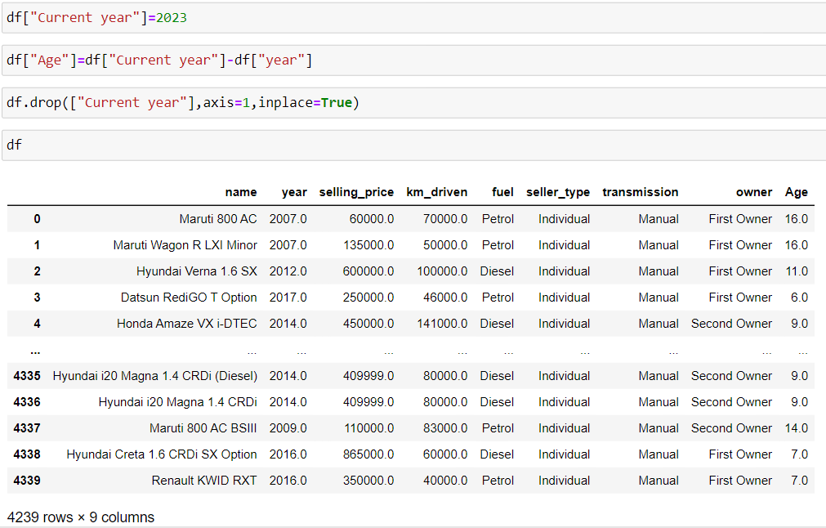
ADDING NEW COLUMN

Slide 13
DATA VISUALIZATION

Slide 14
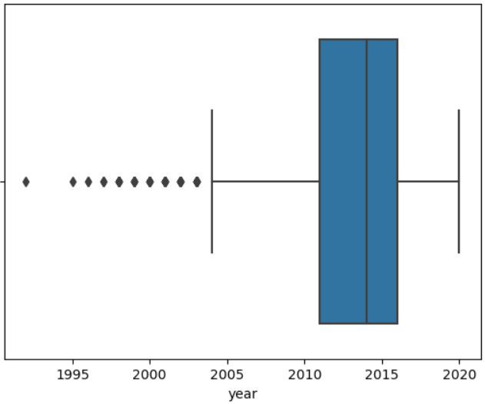
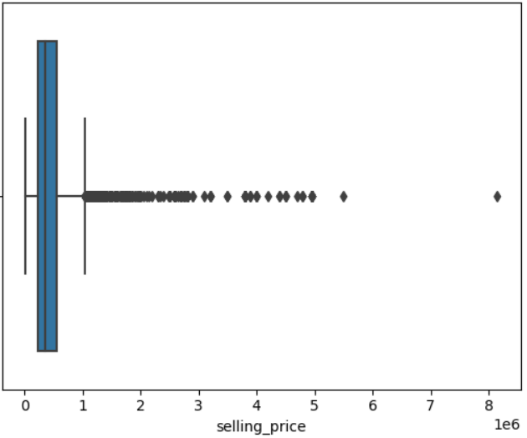
BOX PLOTS
The box plots shown above give details about five point summary of statistical data in graphical format and also highlights the outliers present in the data.

Slide 15
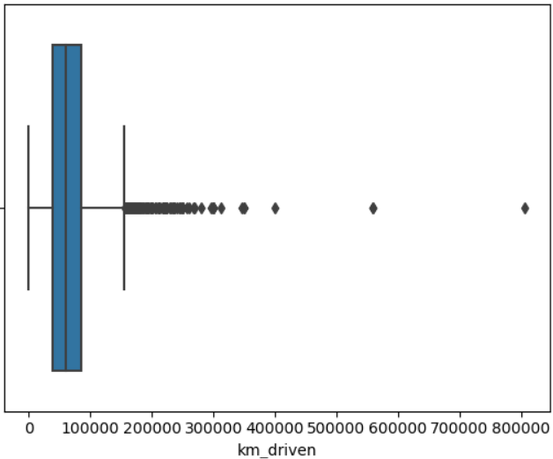
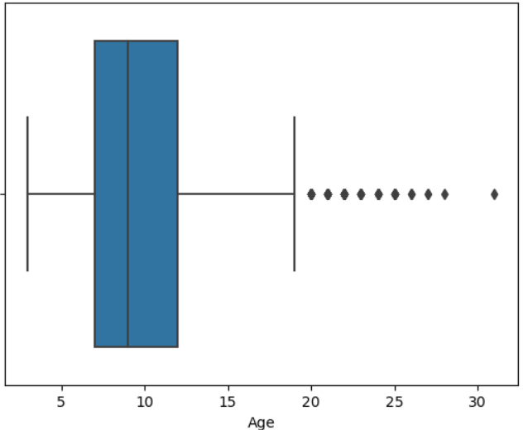
Box plots

Slide 16
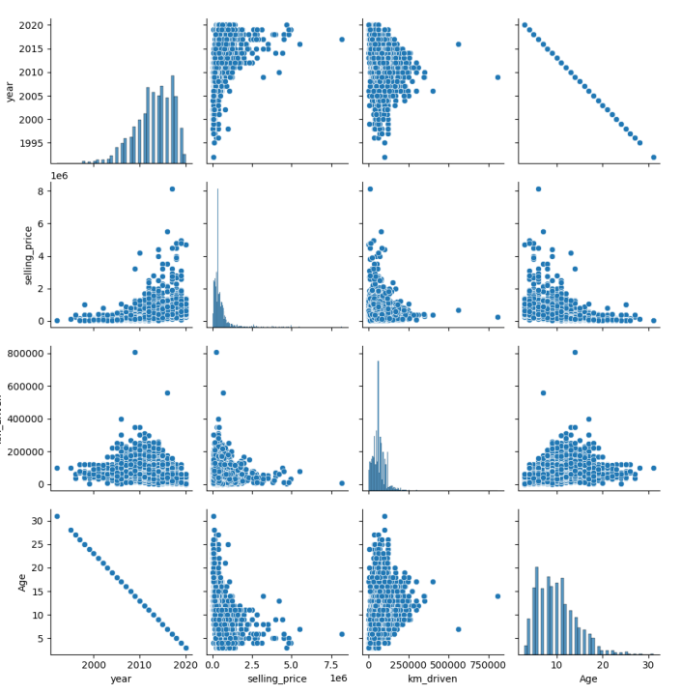
Pair plot

Slide 17
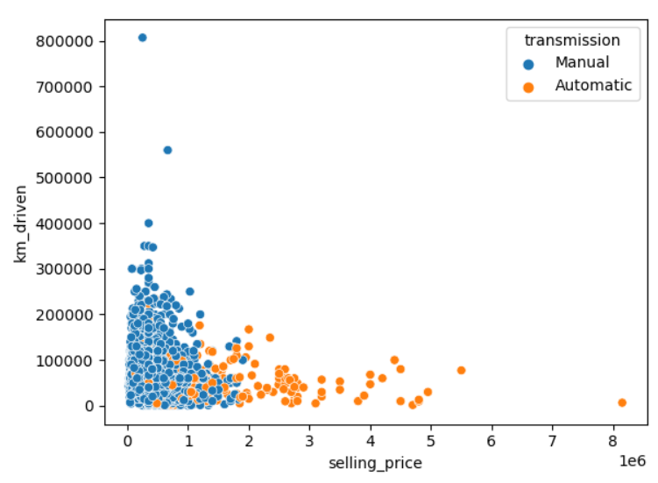
Scatter plot
The scatter plot is showing the selling price according to the kilometres driven.
As can be observed the selling price of the cars with automatic transmission is much higher as compared to manual cars
Few outliers can also be pointed out through the graph

Slide 18
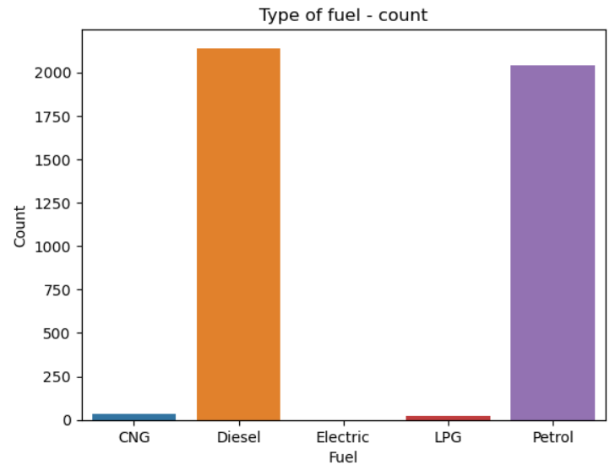
Bar plot
The bar plot shows the counts of different types of fuels used in cars
Diesel and Petrol are among the most popular fuel used in cars
Whereas CNG and LPG are the least popular in the dataset we are analysing.

Slide 19
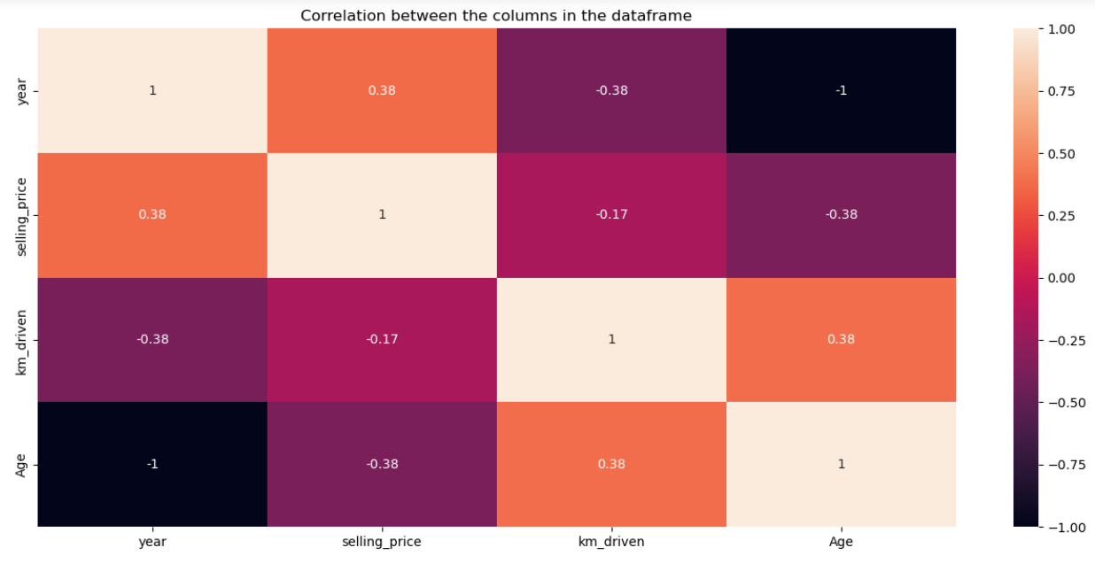
Heatmap of correlation between columns
Selling price and year , km driven and age have the highest correlation
age and year have the least correlation amongst all

Slide 20
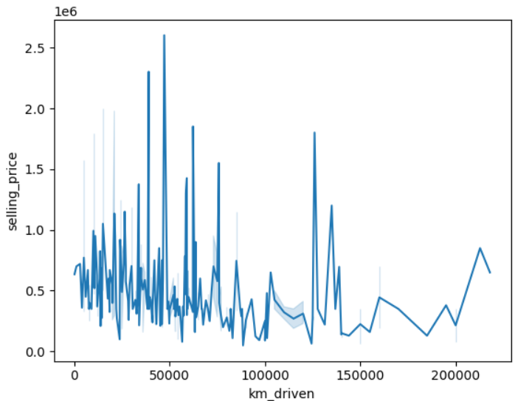
Line plot
The line plot is visualized on a sample of 500 datapoints picked randomly, and we are trying to infer from this data about the population.
The average selling price will lie somewhere close to 1 x e6.
The highest selling price is 2.6 x e6
The lowest selling price is 0.1 x e6.

Slide 21
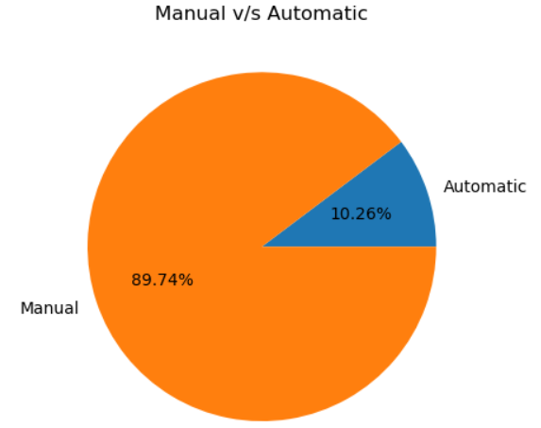
Pie chart
The pie chart represents the distribution of cars with manual and automatic transmission
Only 10.26% of the car have automatic transmission
The rest of the cars are of manual transmission type.

Slide 22
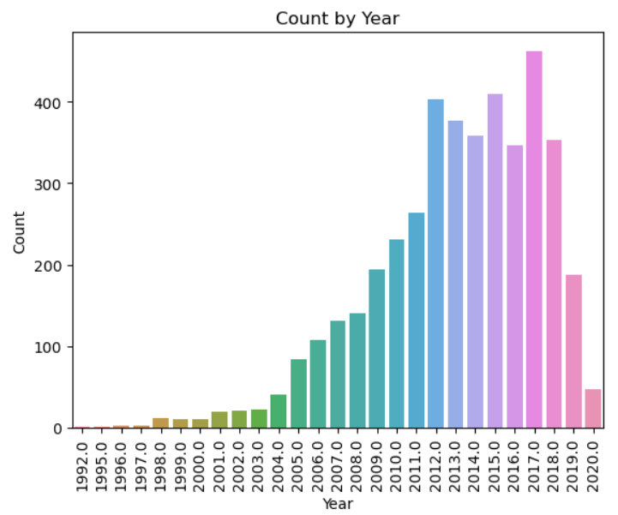
Bar plot
The bar plot shows the count of cars made in specific year
The data is left skewed
Top 5 counts of year are not older than decade ago
We have car dated back to make year 1992

Slide 23
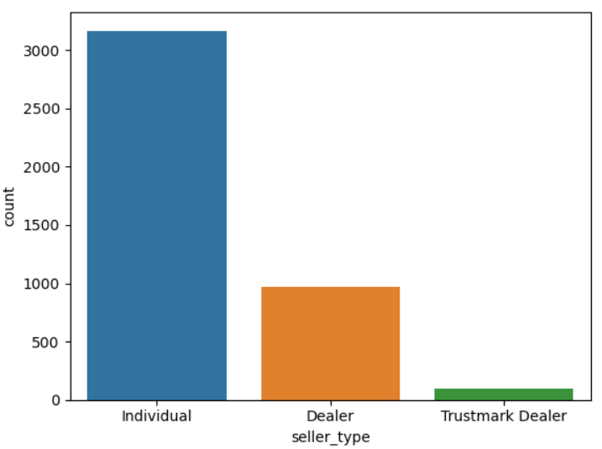
Count plot
The count plot shows different types of sellers in the market.
There are 3 types of seller namely individual, dealer, Trustmark dealer.
Individual seller stands on top with more than 3000 cars
Trustmark dealer is on the bottom with close to 100 cars

Slide 24
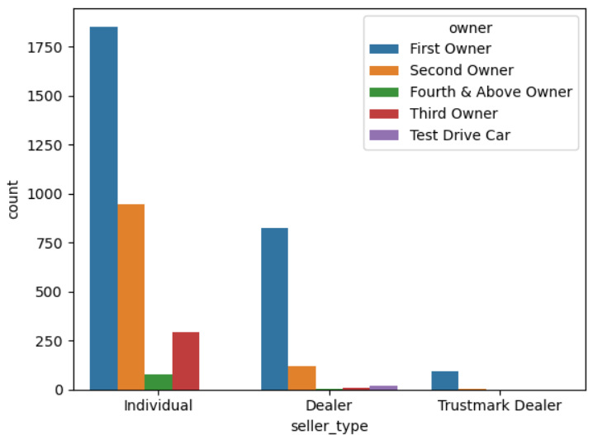
Count plot
The count plot shows frequency of owners of cars side by seller type
First owner is has the highest count in all the three seller types
Only dealers have test drive cars available
Trustmark dealer don’t have third or fourth owner cars

Slide 25
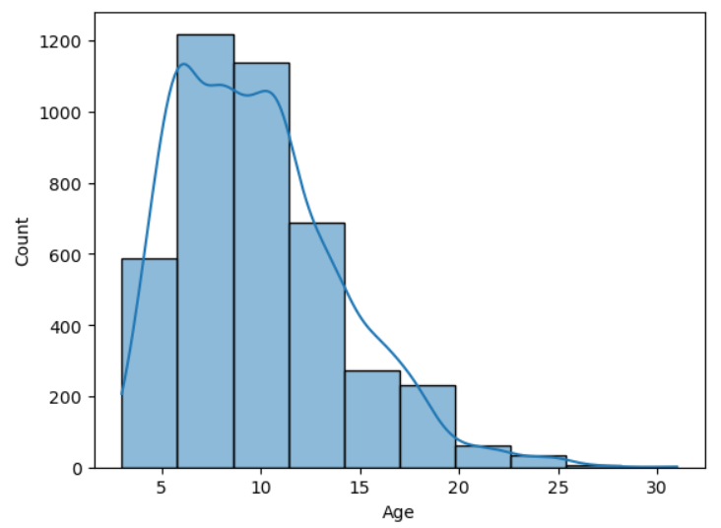
histogram
The histogram shows the count of age of different cars
Highest number of cars are aged between 6 to 8 years.
The most aged car is around 30 years old.
The data is right skewed

Slide 26
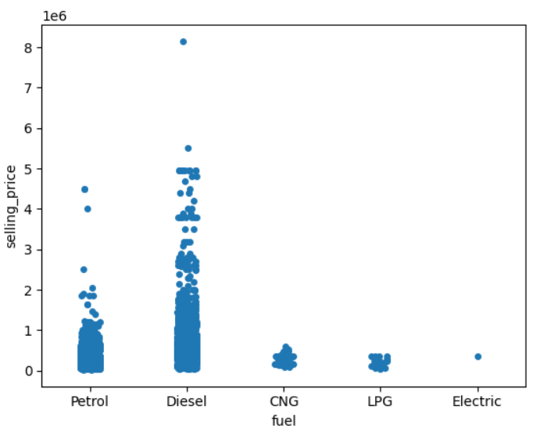
Strip plot
The strip plot shows relation between fuel type and selling price of cars
Diesel cars are more expensive as compared to any other fuel mode
LPG and CNG cars are most economic
Most of the petrol cars are up to 1 x e6 selling price

Slide 27
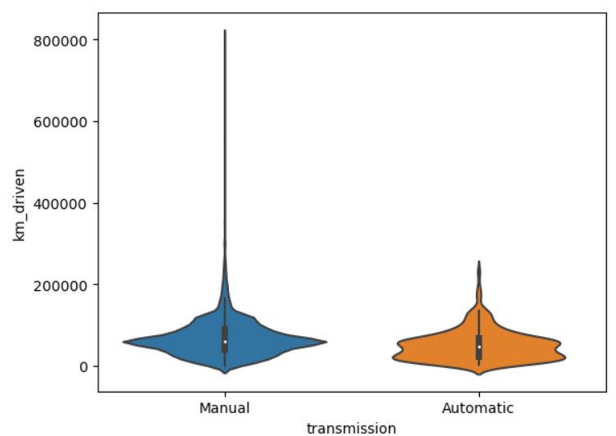
Violin plot
The violin plot gives information about the transmission v/s kilometres driven by car
Both automatic and manual car most of the data is distributed around the median
Clearly there is a outlier value in manual transmission car.

Slide 28
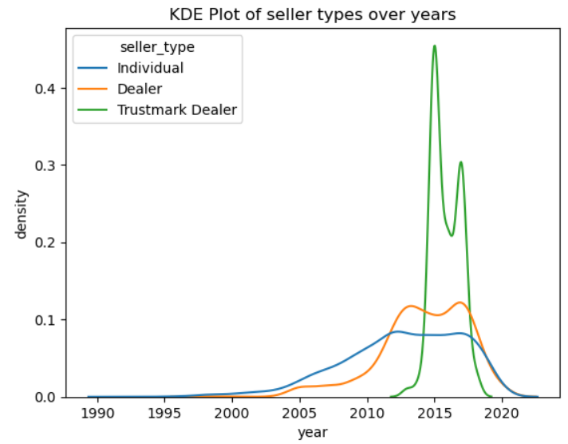
KDE plot
Only individual seller have cars made in 1990 till 2020.
Dealer came into play with cars made in 1998.
Trustmark dealer have the highest density i.e. it have highest number of 2015 models and 2017 models with a drop in 2016 models.
All three seller types have car model from 2012 till 2020.

Slide 29
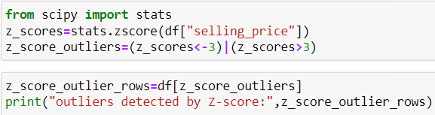
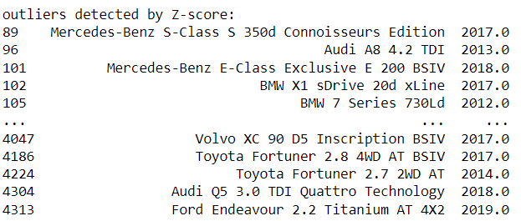
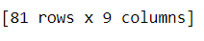
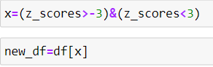
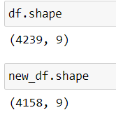
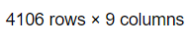
Outliers treatment
Z-score is used for treatment of outliers
The threshold value is 3
We detected 81 outliers in the selling price column and removed them from the data frame.
We can see the change in shape of data frame from 4239 to 4158 rows.
Similar method is used on Kilometres driven column and the final shape of the new data frame is 4106 rows.

Slide 30
Linear regression

Slide 31
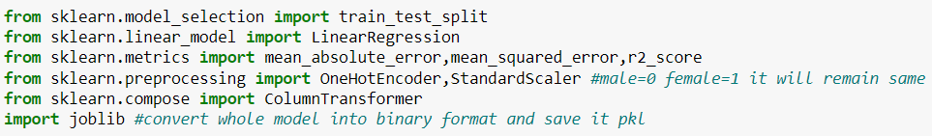
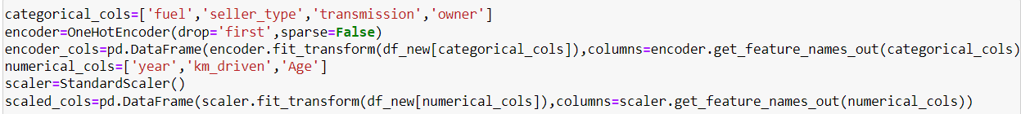
Importing libraries
ONE HOT ENCODING AND SCALING

Slide 32
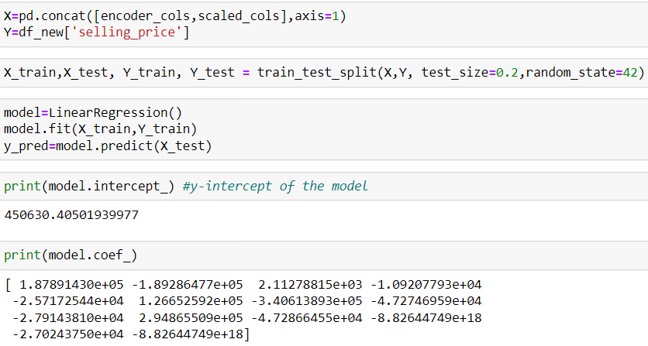
Lr model

Slide 33
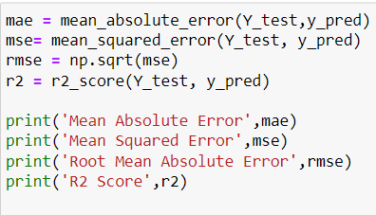

Slide 34
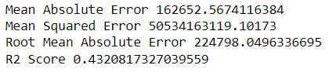
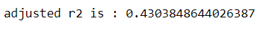
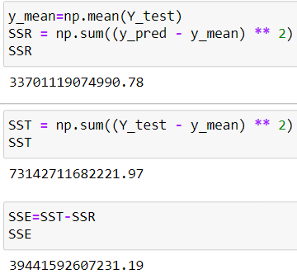
results
MAE gives the average of the absolute difference between the actual and predicted values in the dataset.
MSE gives the average of the squared difference between the original and predicted values in the data set.
RMSE measures the standard deviation of residuals.
R square gives the idea about the model accuracy, here we can say that the model is not good fit (underfitting).

Slide 35
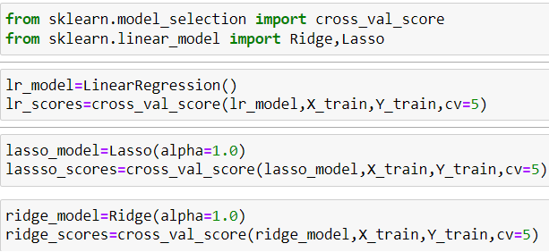
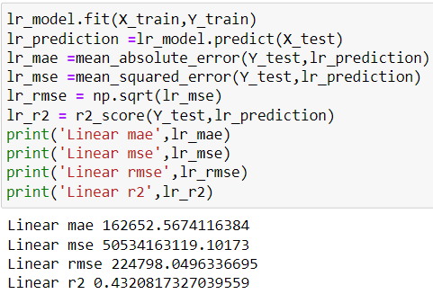
Tuning lr model, lasso model, ridge model

Slide 36
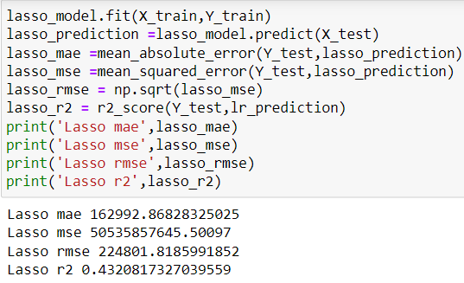
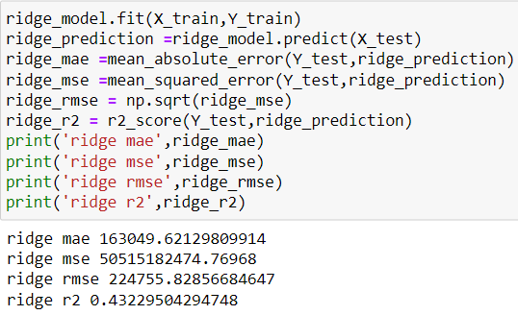
Lasso Model
Ridge Model

Slide 37
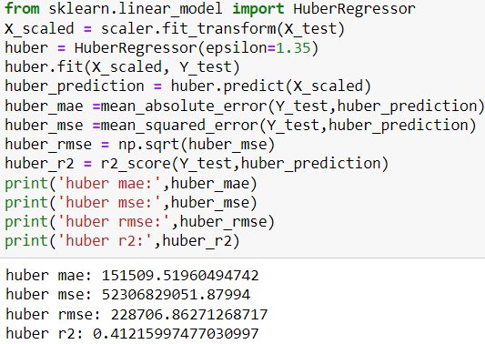
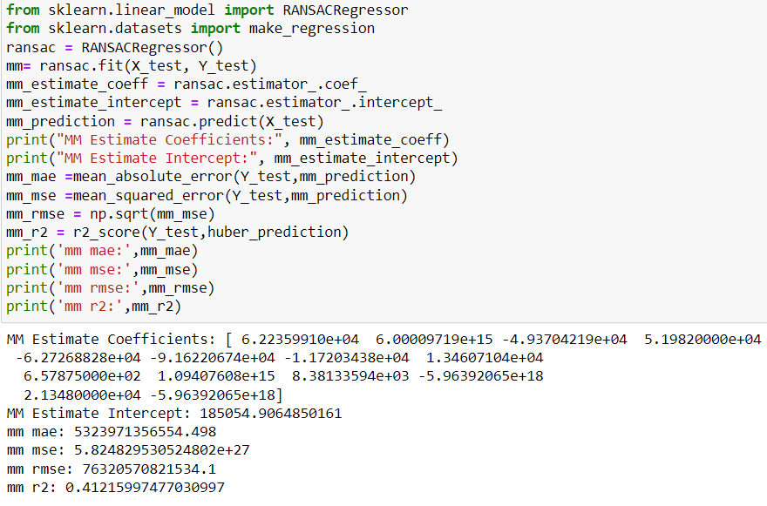
Robust techniques
MM estimate – Huber Regression
MM estimate – RANSAC Regression

Slide 38
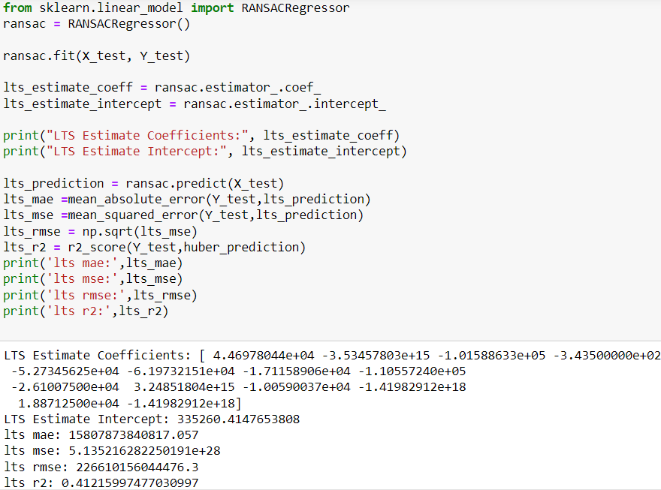
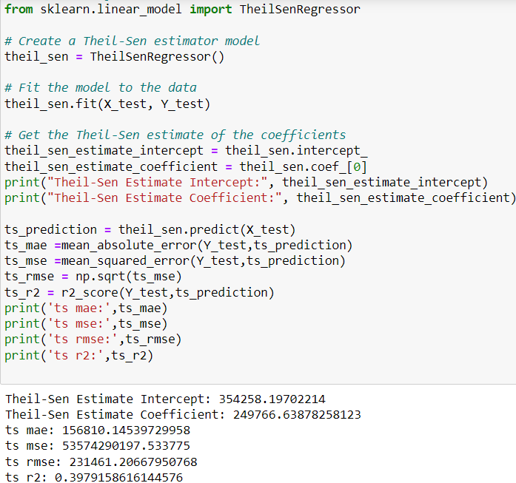
LTS Estimate
Theil Sen Regressor

Slide 39
Conclusion
R square (R²) value – The value of R square is 0.4321 i.e. 43.21% accuracy. which means that the model explains about 43.21% of the variance in the dependent variable. In simple words it’s a moderate fit model and there is room for improvement using different types of algorithms.
Tuning – The value of R square doesn’t changed much by tuning it remains same as before this means the model didn’t show any improvements even after tuning with cross validation score.

